Slide 1


Java SE
(Core JAVA)
Lecture-11

Slide 2
Today’ Agenda
Arrays in Java - Types and Syntax
How JVM handles dynamic blocks?
Using length property of arrays.
Enhanced for loop.

Slide 3
Arrays
An Array is a collection of data of similar data types, be it primitive or non primitive. Example, an array of integers will consist a collection of integer type data, an array of names will be a collection of Strings and so on.
Array in java is treated as an object. So, to create an array we use the keyword new.
Syntax :- There are 2 steps involved in this
Creating array reference –
<data type> [ ] <array reference name>;
Or
<data type> <array reference name> [ ];
Example – int [ ] arr;
Bracket is always left empty.
Here ‘x’ is reference to an array integer.

Slide 4
Creating actual array –
<array reference>=new <data type>[size];
Example :-
int [ ] arr;
arr=new int[10]; or int [ ] arr=new int[10];
* Whenever new is used in java, it gives default value 0 to the object formed
0 1 2 3 4 5 6 7 8 9
0 0 0 0 0 0 0 0 0 0
1000
1000
arr

Slide 5
Initializing the array is same as that in C/C++. Example,
arr[0]=10;
arr[1]=20;
int [ ] arr={10,20,30,40,50} // can be initialized directly.
Size of array can be set by variable which was not allowed either in C and C++. Example,
int n=10;
int [ ] arr=new int[n];
If the size is given negative then NegativeArraySize Exception occurs.

Slide 6
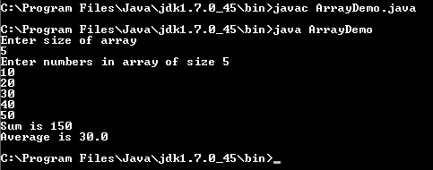
Exercise
WAP to create an array of ‘n’ integers where n is given by the user. Then ask the user to input value in that array & finally display the sum and average of all the numbers entered by the user ?

Slide 7
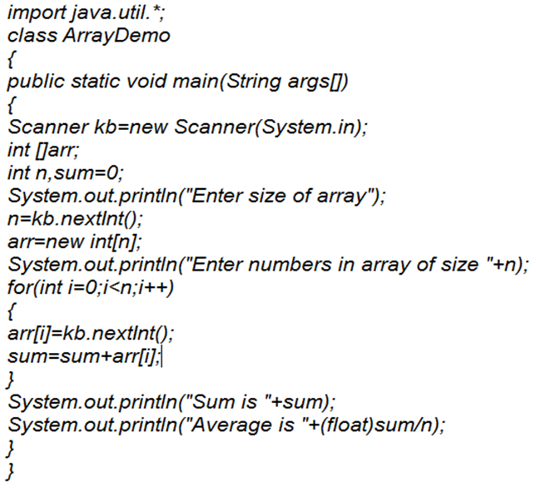
Solution

Slide 8
De allocation of Dynamic Blocks
To understand de allocation of dynamic blocks in java, we first have to understand the concept of garbage blocks.
Garbage blocks in java are those dynamic blocks which are no more referred by any reference. For example, let us consider two arrays
int [] A={10,20,30,40,50};
int [] B={60,70,80,90,100};
A=B;
* Now, at this point the array with address 1000, is no more pointed by any reference. Hence, it is a garbage block.
Garbage Block
1000
10 20 30 40 50
A
1000
1000
60 70 80 90 100
B
2000

Slide 9
Garbage Collector
To collect these garbage blocks from the main memory and deposit them back into free pool, Java internally uses a software (build into JVM) named garbage collector.
The garbage collector periodically scans program’s memory area identifies garbage blocks and submits them back into free pool.
The programmer is completely unaware of this activation process of garbage collector.
So, in java dynamic blocks or objects have undetermined life time, as they are created on programmers request and de allocation is exclusively handled by JVM.

Slide 10
Initializing an array
We can initialize array in different ways as a programmer
int [ ] arr=new arr[5];
arr[0]=10;
arr[1]=20;
arr[2]=30; // and so on…
int [ ] arr=new arr[ ]{10,20,30,40,50};
int [ ] arr={10,20,30,40,50};
Initializer

Slide 11
Using length property
Properties are special methods which can we called without using parenthesis. Programmers cannot develop properties in their class.
By using this property we can easily get the size of an array.
The length property can be used on any type of array and it is a read only property, nothing can be assigned to length.
Example :- int [ ] arr= {10,20,30,40,50,60,70,80};
System.out.println(“Size of array is ”+arr.length);

Slide 12
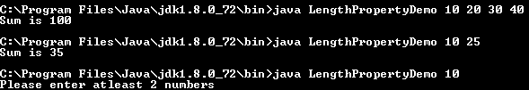
Exercise
WAP which accepts some integers using Command line arguments and displays their sum. In case numbers passed are less then two, the program should display the message “Please pass at least 2 numbers”.
Sample output :-

Slide 13
Solution
class LengthPropertyDemo
{
public static void main(String [] args)
{
int n,sum=0;
n=args.length;
if(n<=1)
{
System.out.println("Please enter atleast 2 numbers");
System.exit(0); // same as exit( ) function in C
}
for(int i=0;i<n;i++)
sum=sum+Integer.parseInt(args[i]);
System.out.println("Sum is "+sum);
}
}

Slide 14
Enhanced for loop
Enhanced for loop was introduced in Java in its version 5.0.
Syntax :-
for( <data type><variable name> : <array reference>)
{
-----
-----
}
* Variable’s data type should be same as that of the array.
This loop is mainly used to perform read only operations. We cannot change or manipulate array values using this loop.
Let’s understand this through an example…

Slide 15

Example
class EnhancedForDemo
{
public static void main(String [] args)
{
int [ ] arr={10,20,30,40,50};
for(int x : arr)
{
System.out.println(x);
}
}
}

Slide 16
Drawbacks of Enhanced for loop
Array cannot be traversed from the end, it will always start from the first element.
The array will be traversed completely, it will not exit the loop at any intermediate point.
The variable has to be declared in the loop brace, it is a part of it’s syntax.
We can only perform read only operations i.e. traverse the array, no change or manipulations can be made in the array.

Slide 17

End Of Lecture 11
For any queries mail us @: scalive4u@gmail.com
Call us @ : 0755-4271659, 7879165533
Agenda for Next Lecture:
Two dimensional arrays
Rectangular 2D arrays
Jagged 2D arrays

